Slide 2

Tesla & Me – Best Friends!
Marcel Zehner | Corporate Ambassador itnetX
Microsoft Regional Director (RD)
Microsoft Most Valuable Professional (MVP)
marcelzehner.ch | @marcelzehner

Slide 3
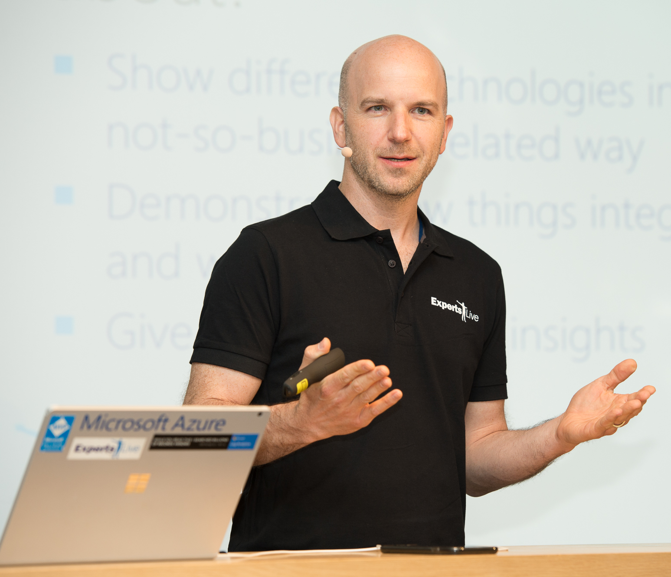
About Me
itnetX Global Alliance
Switzerland
Microsoft MVP & RD
Microsoft Azure addict
IT & tech geek
Speaker & blogger
Community supporter
World traveller
Group fitness fanatic
Tesla driver
Notes:
About me
Why this session

Slide 4
Tesla Insights

Slide 5
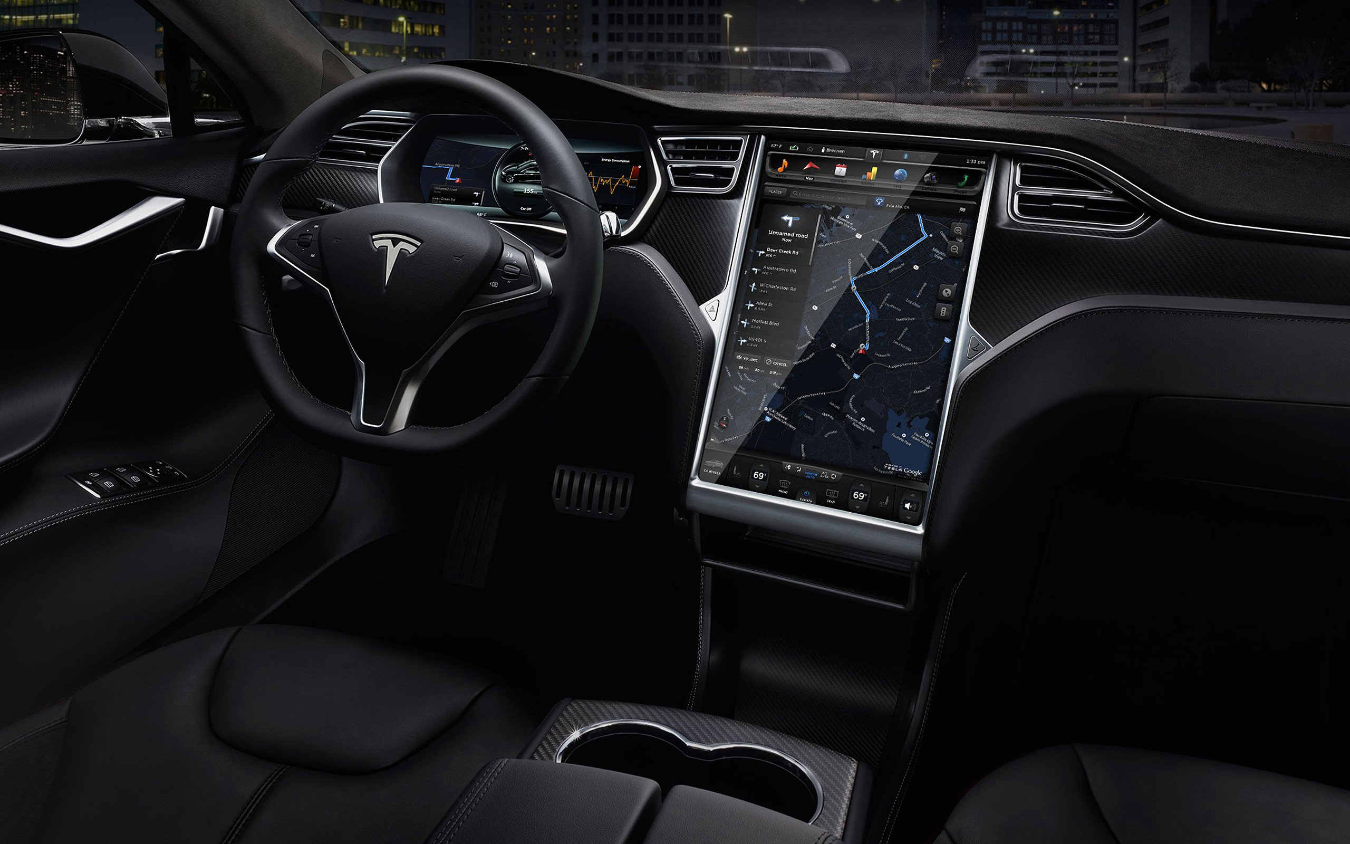
Notes:
Dashboard screen 17’’ (Control everything)
Center screen (Autopilot, Apps)
2 separated systems, run a modified version of Linux

Slide 6
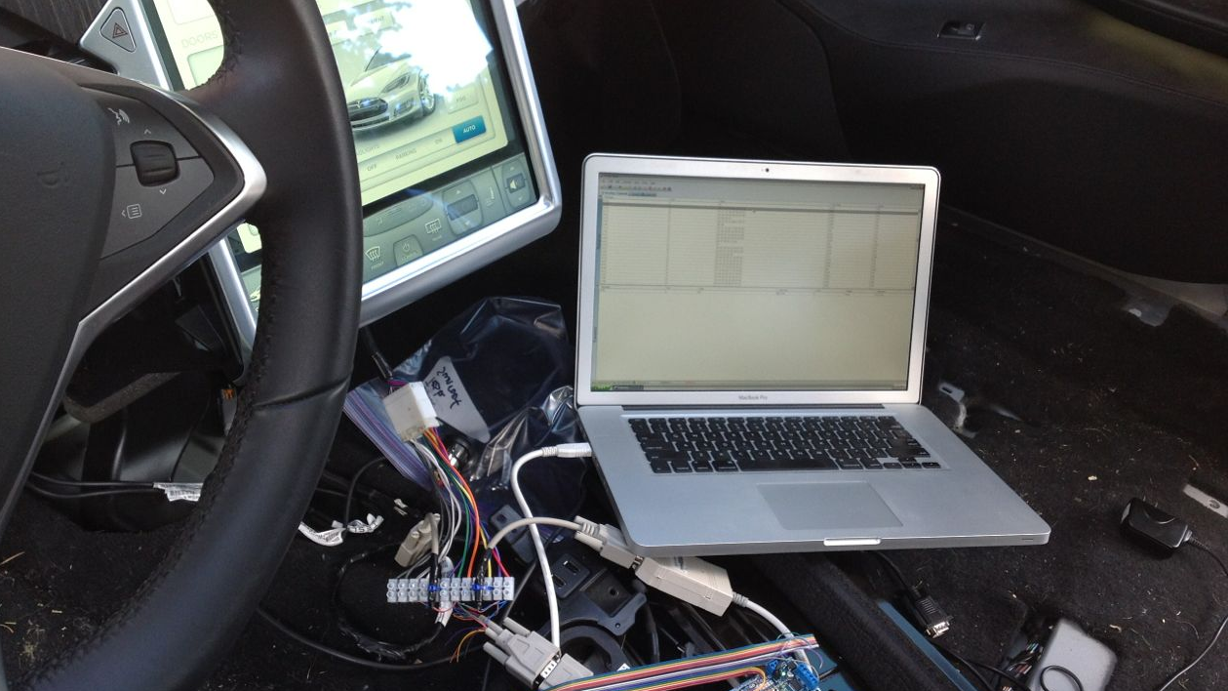
Notes:
Physical access

Slide 7
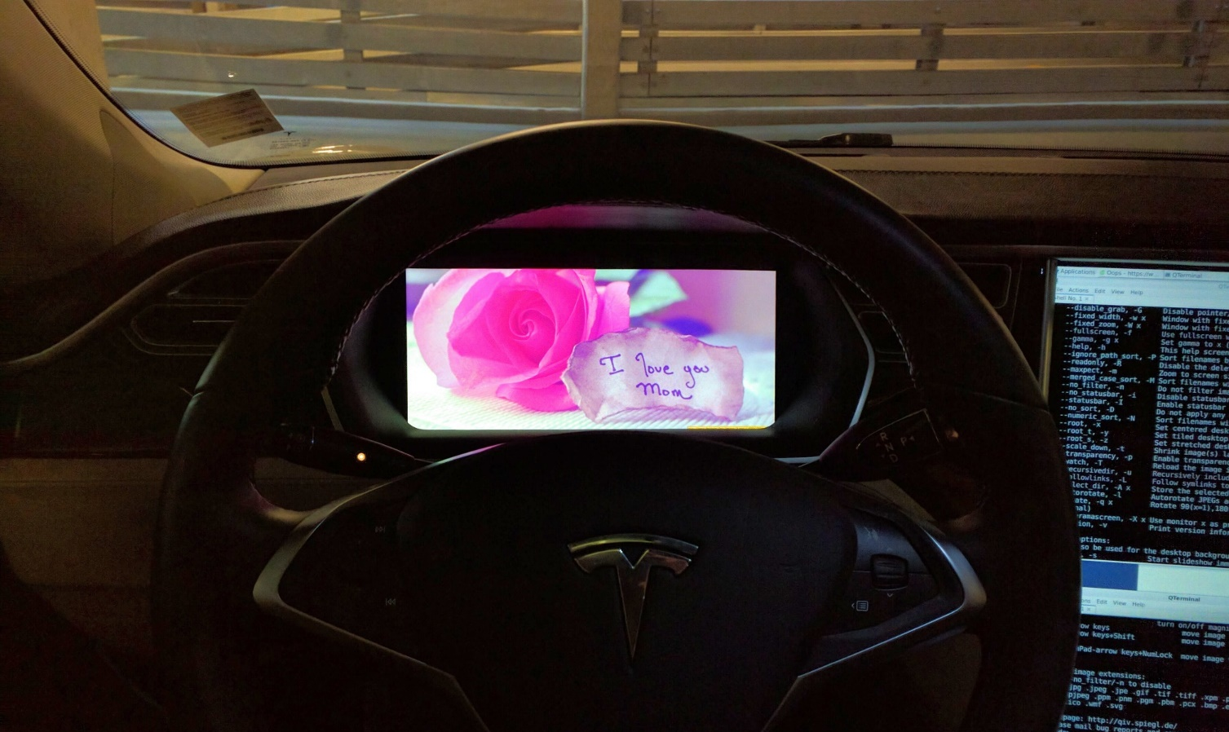

Slide 8
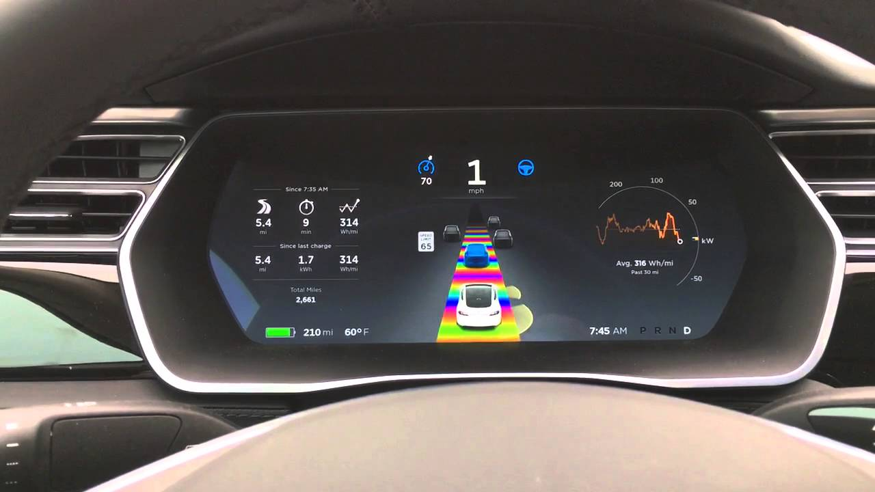
Notes:
Easter Eggs (Rainbow Road, Santa, Mars Rover, Sketchpad ….)

Slide 9
Video “Sketchpad”

Slide 10
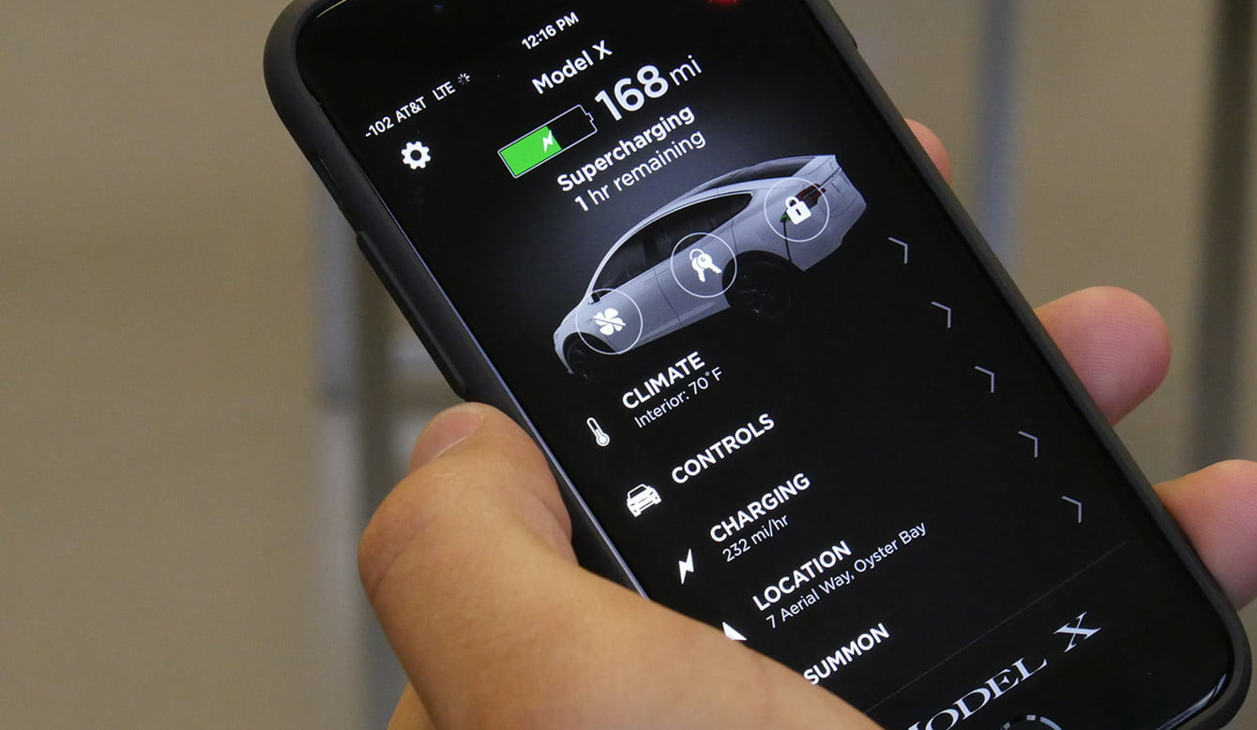
Notes:
App to read data and control the car

Slide 11
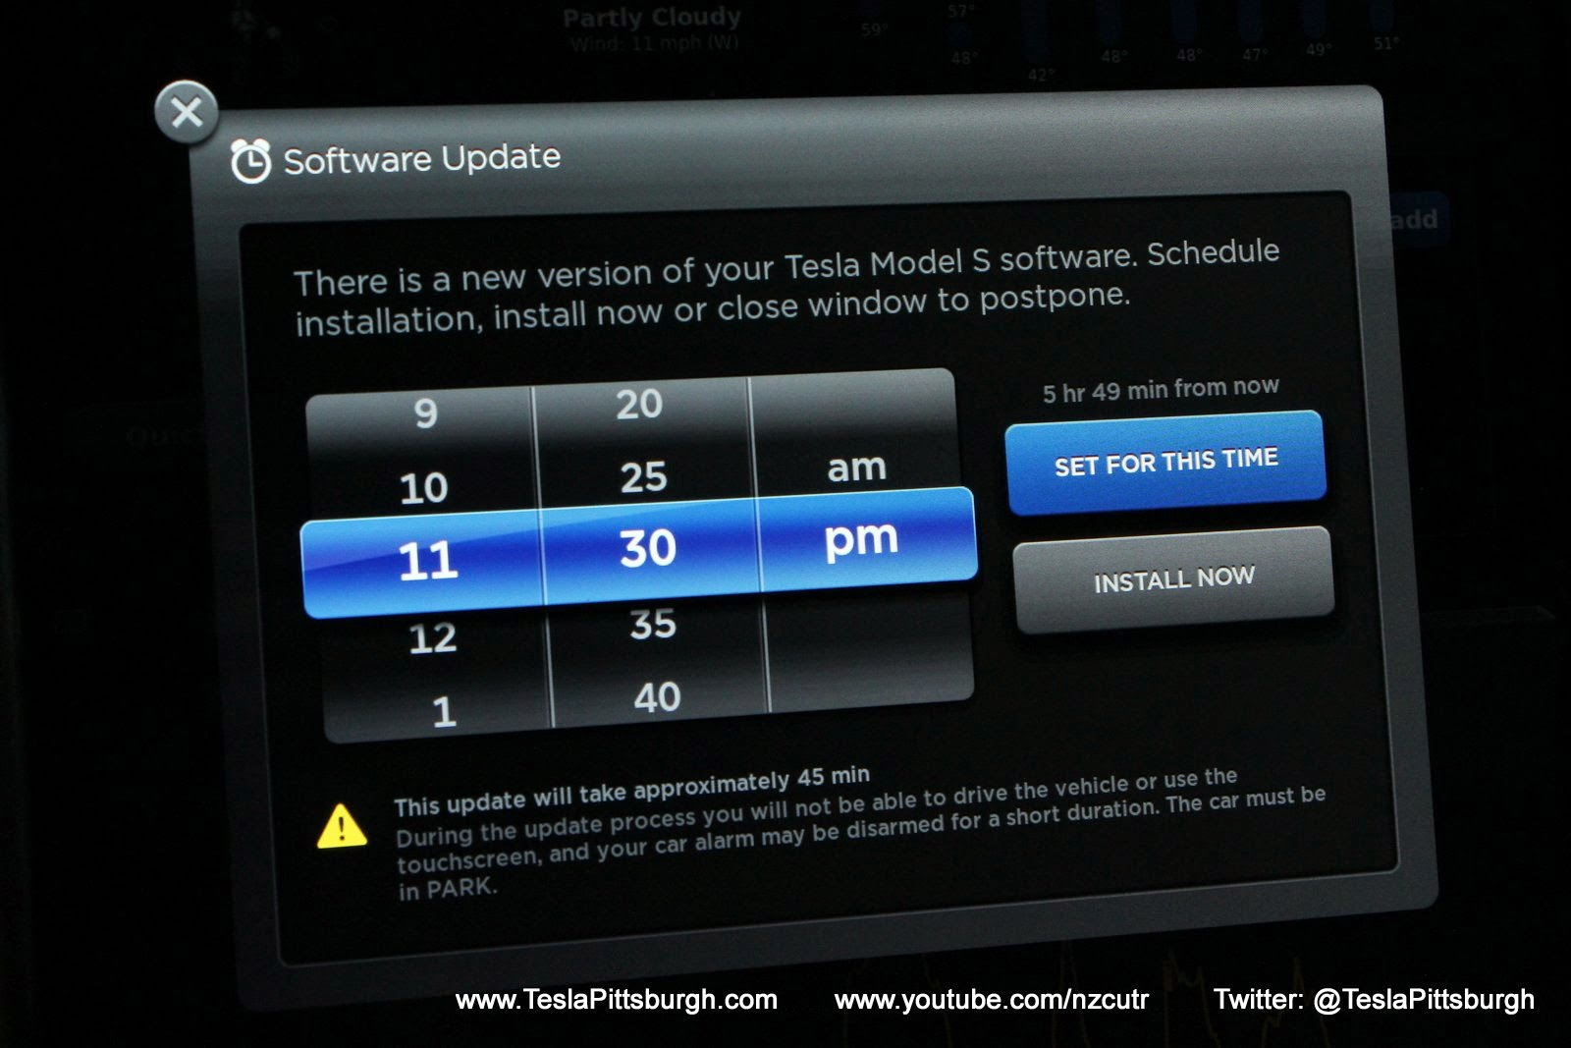
Notes:
Obviously the vehicle is always connected to the internet (SIM card)
Download Software Updates
Upload telemetry data

Slide 12
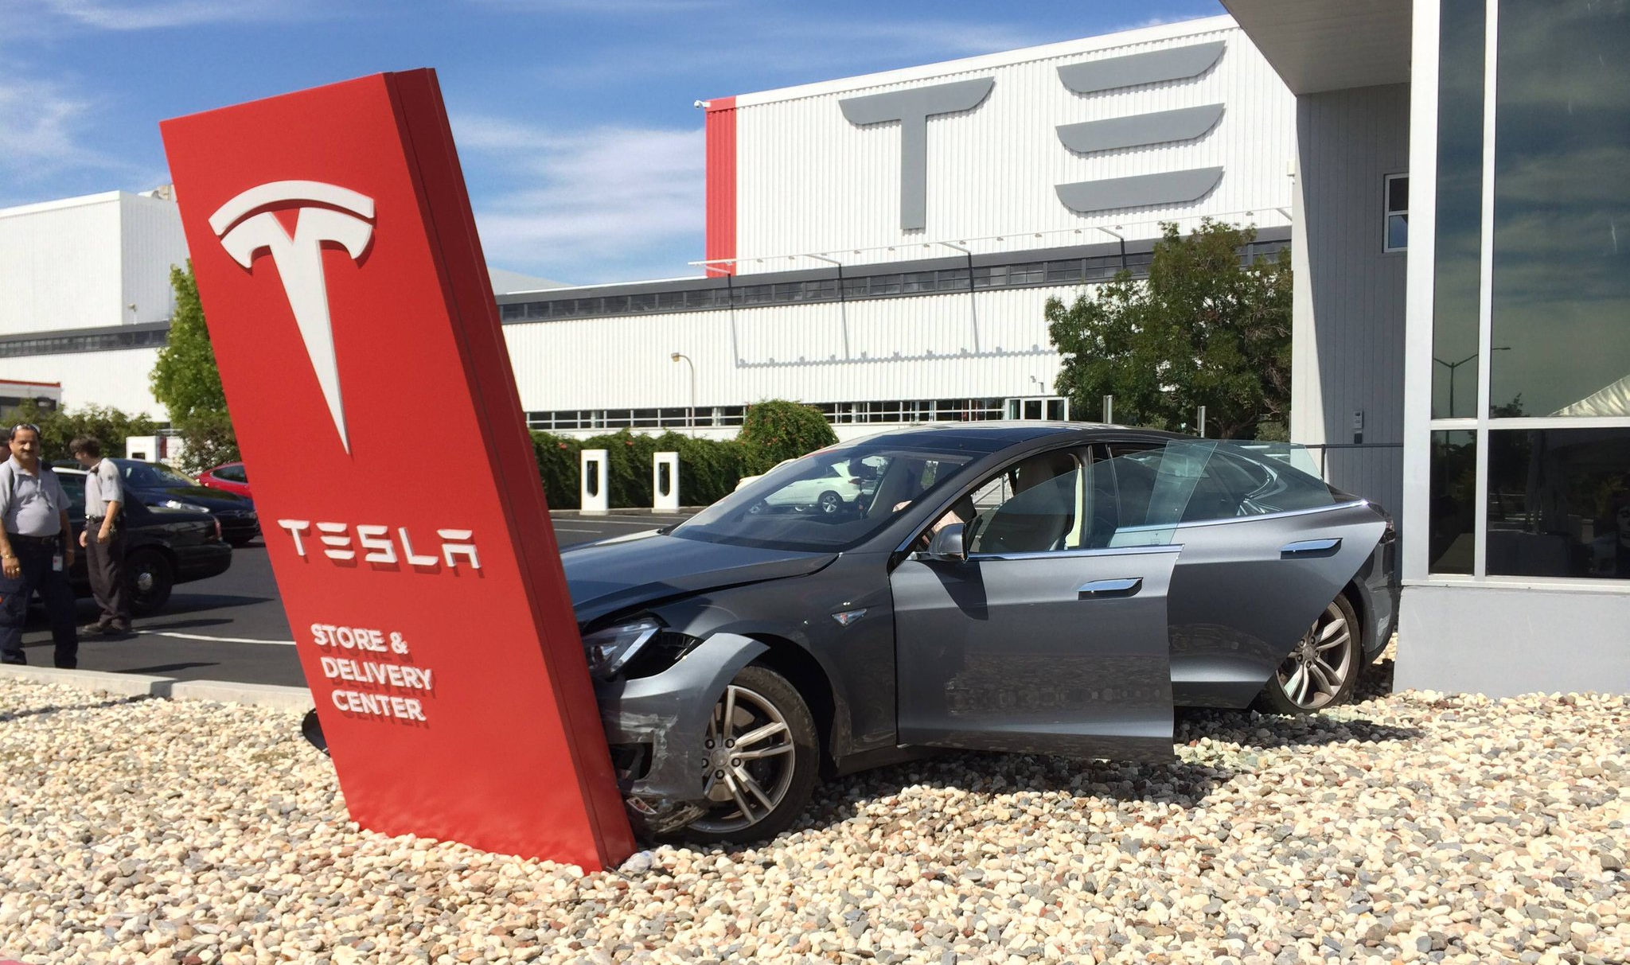
Notes:
Support Story

Slide 13
Video “Reboot”

Slide 14
Meet My Friend

Slide 15
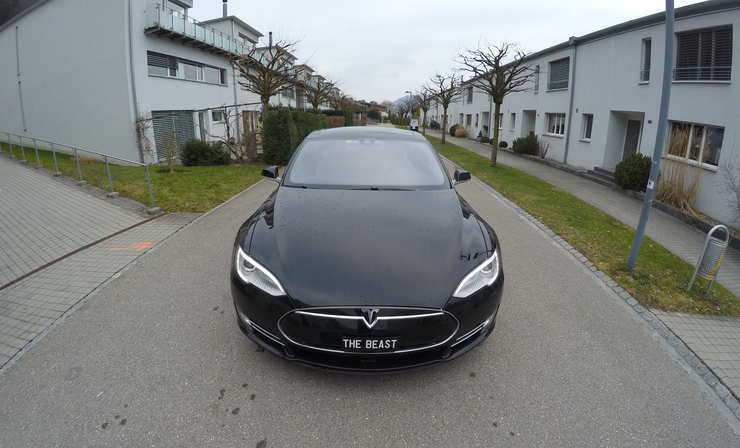
Notes:
The Beast
Secret location in a safe country

Slide 16
Live Demo

Slide 17
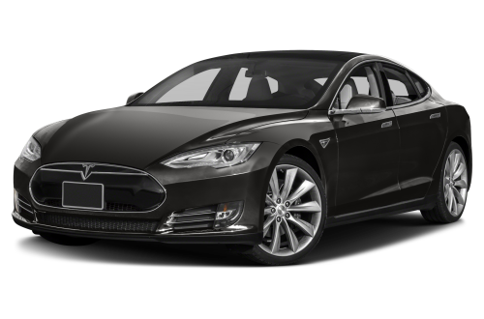
Live Demo Recap
Custom Desktop App
Amazon Alexa
Azure Alerts
Tesla App
PowerShell
Azure Functions
Azure Log Analytics
Power BI
APIs
And there is more …
SCOM management pack
Dockerized .NET core app
Microsoft Band app
Microsoft Flow extension
SCSM self service portal offerings with automation
Windows Mobile Phone app with Cortana integration
Tesla Account

Slide 18
Tesla & Me – Best Friends!
Marcel Zehner | Corporate Ambassador itnetX
Microsoft Regional Director (RD)
Microsoft Most Valuable Professional (MVP)
marcelzehner.ch | @marcelzehner

